Slide 1
Project Research Questions:
Key research Questions:
What are the weaknesses of tree search algorithms within the GVG-AI competition
What are the best proposed methods of improving their limitations for this competition
What are the best kind of MCTS enhancements for GVG-AI
Could a hyper-heuristic be created from the strengths of multiple MCTS modifications?

Slide 2
Hypothesis:
Does MCTS with enhancement x perform better than vanilla MCTS
Does MCTS with enhancement y perform better than vanilla MCTS

Slide 3
How does this contribute to knowledge in this field?
This research will help gather knowledge into the limitations of different game tree search techniques for AI.
To create a hyper heuristic agent that has been modified from the strengths and weaknesses found in different tree search techniques.
Also by looking at how the scaling of different metrics within the competition frame work and seeing how they affect the performance of different agents.
There are a lot of different controllers that are modifications to MCTS, but there has been little research as to how the modifications compare with each other.

Slide 4
How the data is being collected
A json file is created with the stats from the end of the game
A screen capture of the game with an overlay of how long the agent spent in each cell
That data will help show the agents patterns, within the different games.

Slide 5
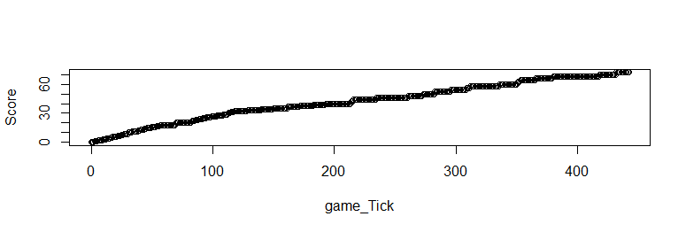
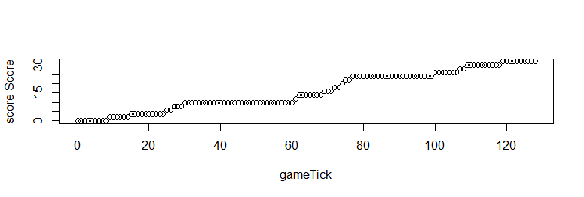
Current Results:
Measuring the score over time
sampleOLMCTS
sampleMCTS
From this data, it can show how fast the agent can find rewards in a game

Slide 6
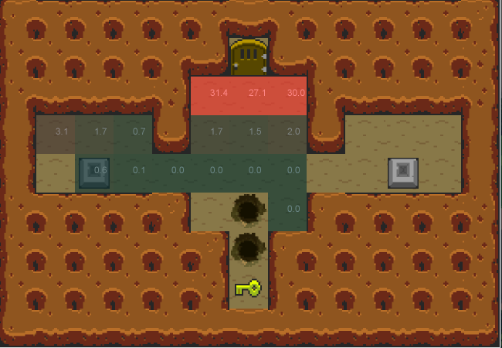
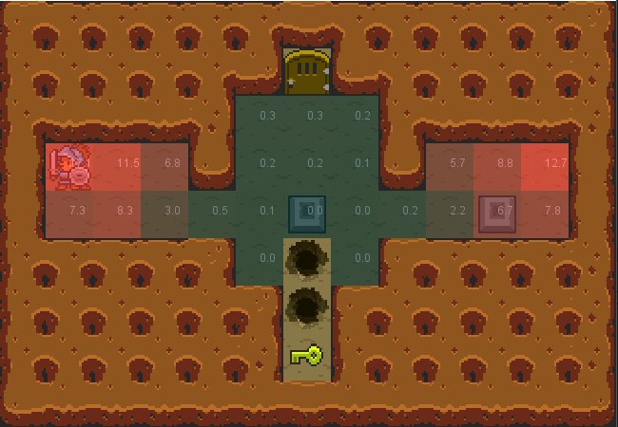
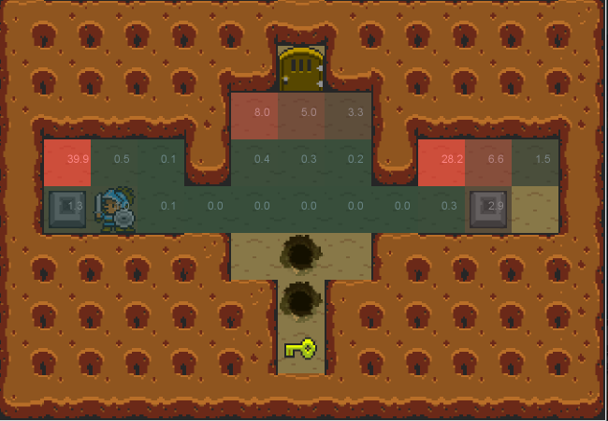
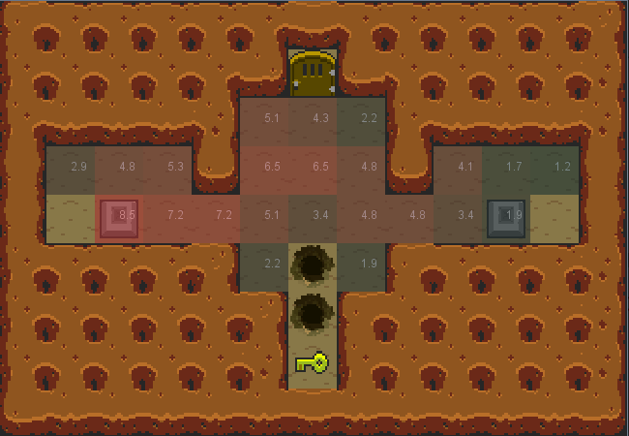
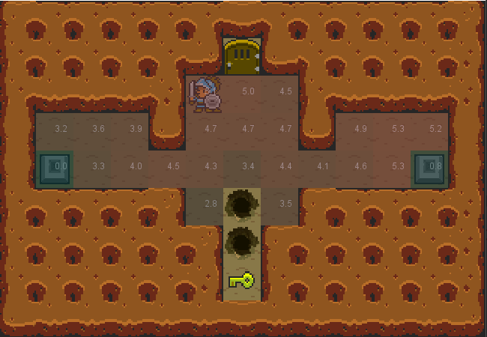
Current Results:
Different MCTS variations:
OLMCTS controller after 10 Games
MCTS controller after 10 Games
FlatMCTS controller after 10 games
Others:
Random
OSLA(One Step Look Ahead)

Slide 7
What next:
What next:
Gather a list of different MCTS modifications
Compare the data gathered from the thousands simulations
Look at the strengths and weaknesses of different modifications
Create a hyper heuristic based of that data

Slide 8
What methods have I applied to getting these results?
By visualizing where the controllers spend most of their time within the levels of different games, conclusions can be drawn from whether the agents get stuck or explore the level
From this a hyper heuristic can be formed based on the strengths of different agents.
Furthermore the additional data collected from the games can be loaded into R and be used to contrast the different statistics of the controllers.
Examples of the data that will be collected are:
Score
Game space searched
Level size
Total cells explored

Slide 9
What are you likely to conclude on the basis of this research?
Need more data for a conclusion.

Slide 10
Questions?

